Slide 1


Wireless And Mobile Propagation Project
Prof. Michele D’Amico
5 August, 2025

Slide 2


Radio Mobile Project (PMR) Network Design for Shahr-e Bābak City
Team Members
Mohammadreza Zamani
Asal Abbas Nejad Fard

Slide 3
Contents​
Introduction
Design of the Network
Results
Conclusion

Slide 4
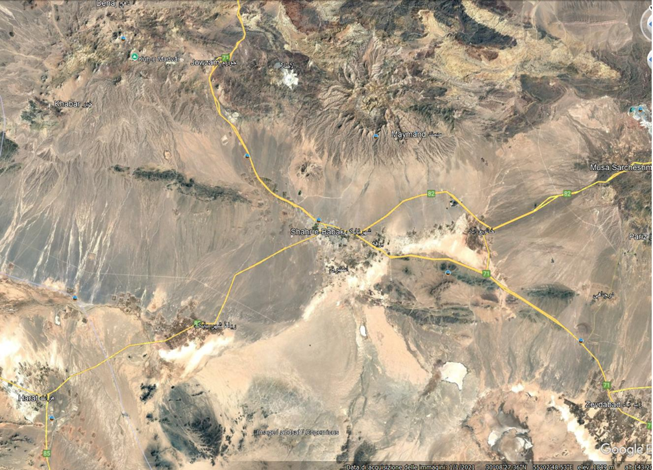
Introduction
In Shahr-e Bābak City, Iran, we provide a strong and dependable Private Mobile Radio (PMR) network for digital voice and data transmission. The network covers a square area of 100 km by 100 km, with Shahr-e Bābak City located at its center. For network planning and analysis, we use Radio Mobile.
​

Slide 5
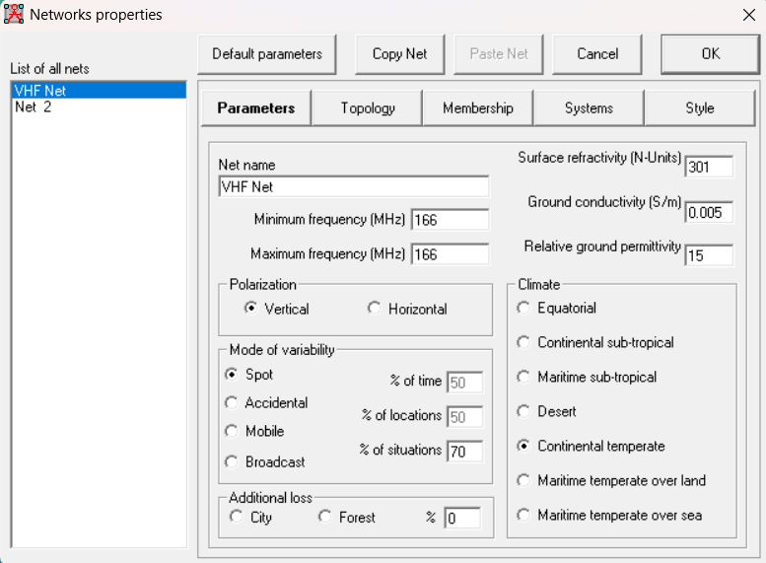
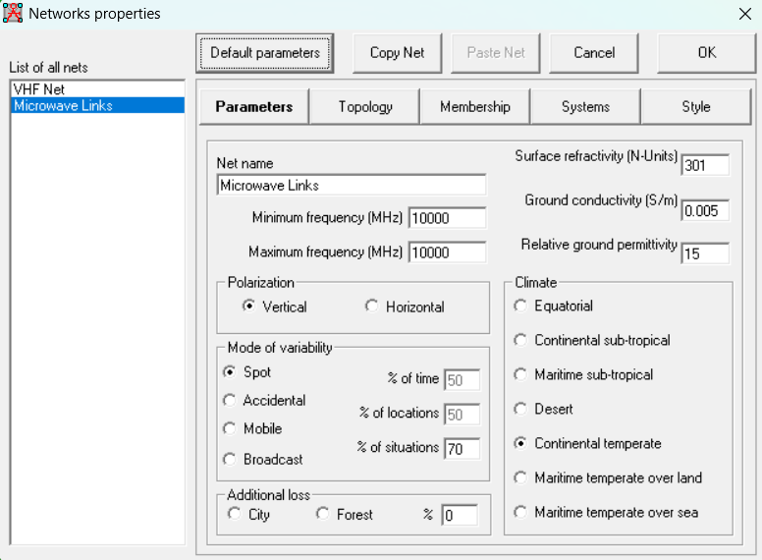
Network Design
After reaching a user's signal to the nearest repeater, this signal is transmitted via microwave links to every other repeater. The signal is then retransmitted by all repeaters on the user access frequency (VHF), enabling simultaneous listening by the Operations Center and all users.
In this project, mobile users connect to the nearest repeater at 166 MHz and connect all repeaters at 10 GHz.
​

Slide 6
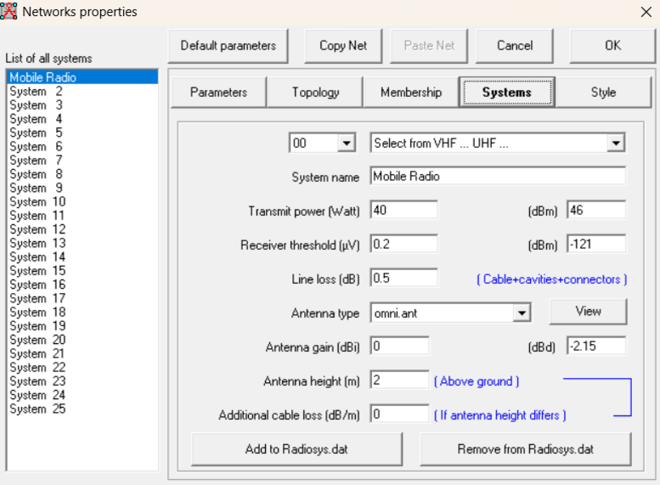


Network Design: VHF
Mobile Unit Configuration
Operation Frequency: 166 MHz
Modulation Type: ETSI Digital Mobile Radio (DMR)
Motorola DM4000e vehicular terminals.​
Transmit Power: 40 W.
Sensitivity: 0.18 µV.
Antenna Gain: Assumed as 0 dBi

Slide 7

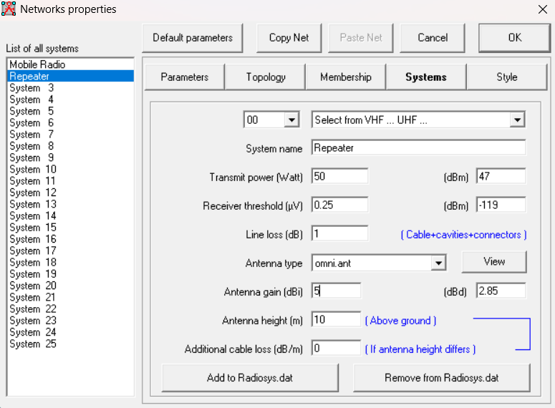
Repeater: Motorola SLR5500 (DMR)​
Power Output: 50 W
Sensitivity: 0.22 µV.​
Signal Gain: 5 dBi.
Antenna Height: 10 m
Coaxial Cable (VHF): RT 50/20 low-loss cable
Loss: ~0.6 dB for 10-meter run at 166 MHz​
Network Design: VHF

Slide 8
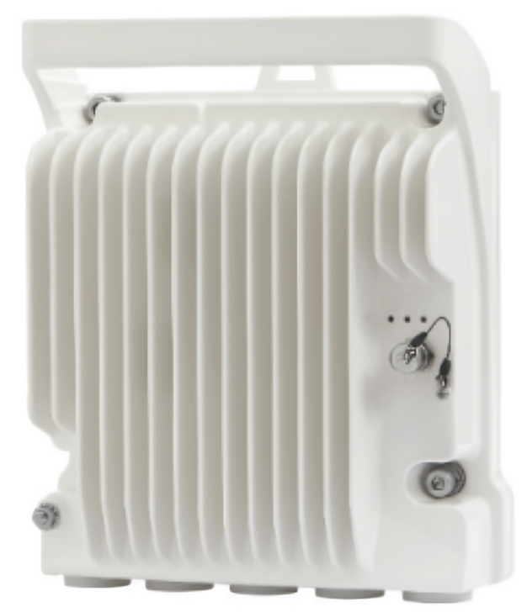
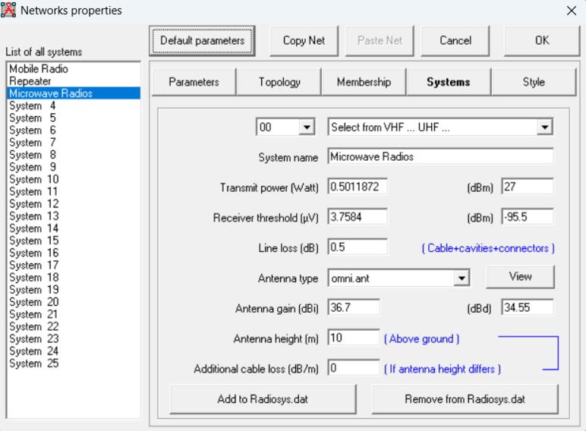
To provide dependable routing, every repeater needs to see at least two other repeaters.
Network Design: Microwave Net
Operation of the Frequency: ​
Urban (< 5 km): 32 or 38 GHz​
Short Haul (0–10 km): 18 or 23 GHz
Mid Haul (10–25 km): 13 or 15 GHz
Long Haul (25–70 km): 7 or 10 GHz

Slide 9
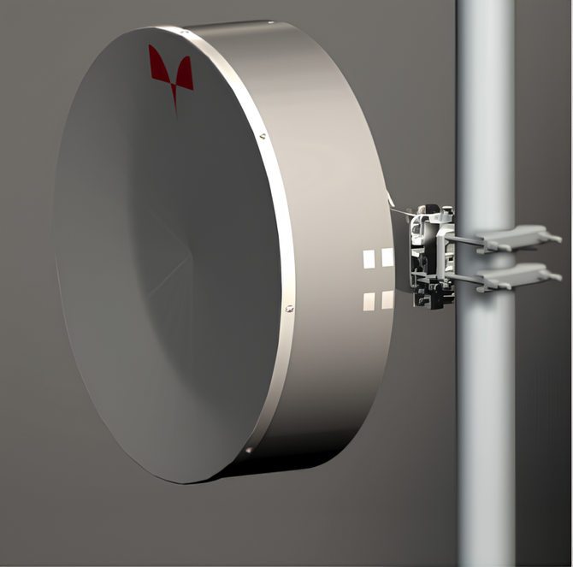
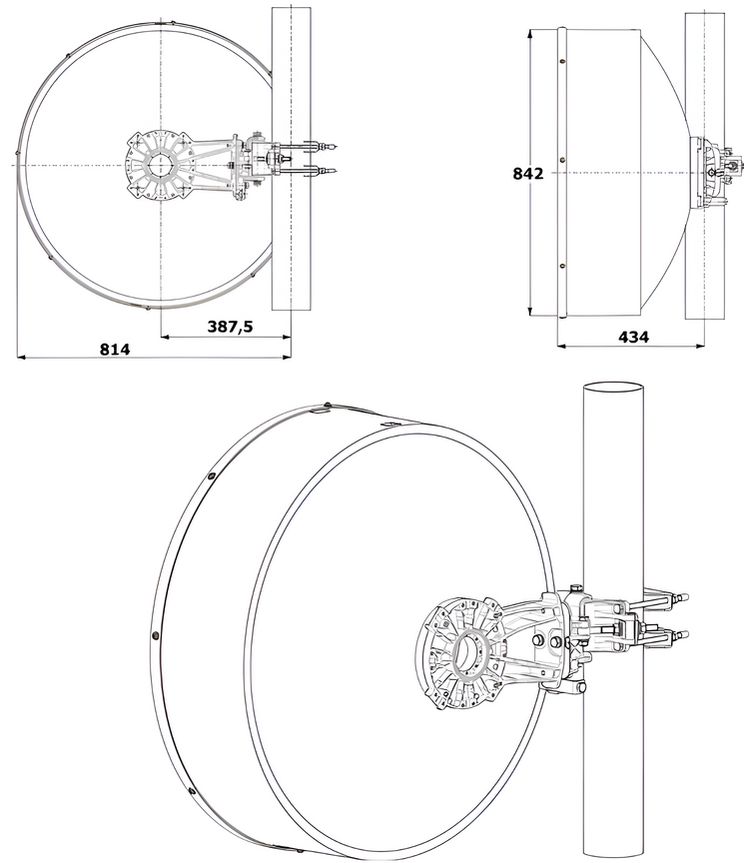
Microwave Antenna Characteristic:​
Diameter: 0.8m
Frequency Range: 10 or 11.7 GHz
Gain of Midband: 36.7 dBi
Wind velocity operational: 30 m/s
Antenna Dimensions: 842 mm height, 814 mm width, and 434 mm depth.
Construction: Wind-resistant, industrial-grade, and appropriate for installations in mountains.
Network Design: Microwave Antenna

Slide 10
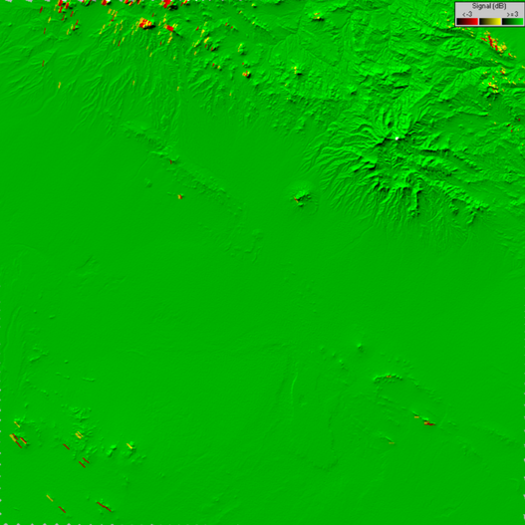
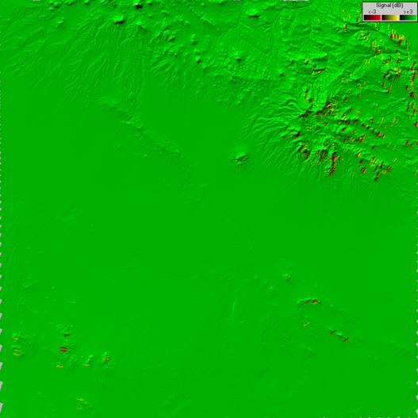
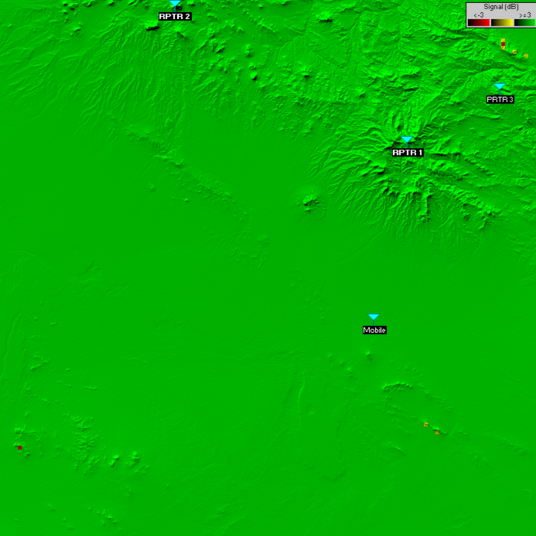
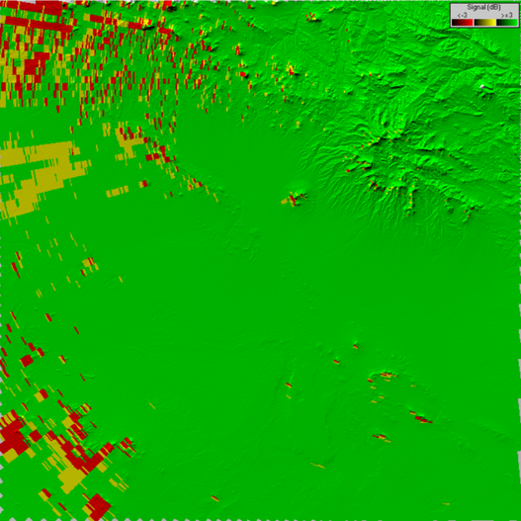
Results
To ensure wide-area radio coverage with optimal efficiency, three repeater sites were strategically installed at elevated locations. Site selection was driven by terrain elevation and line-of-sight advantages to reduce signal blockage from natural obstacles. Each repeater was configured to maximize surface coverage.

Slide 11
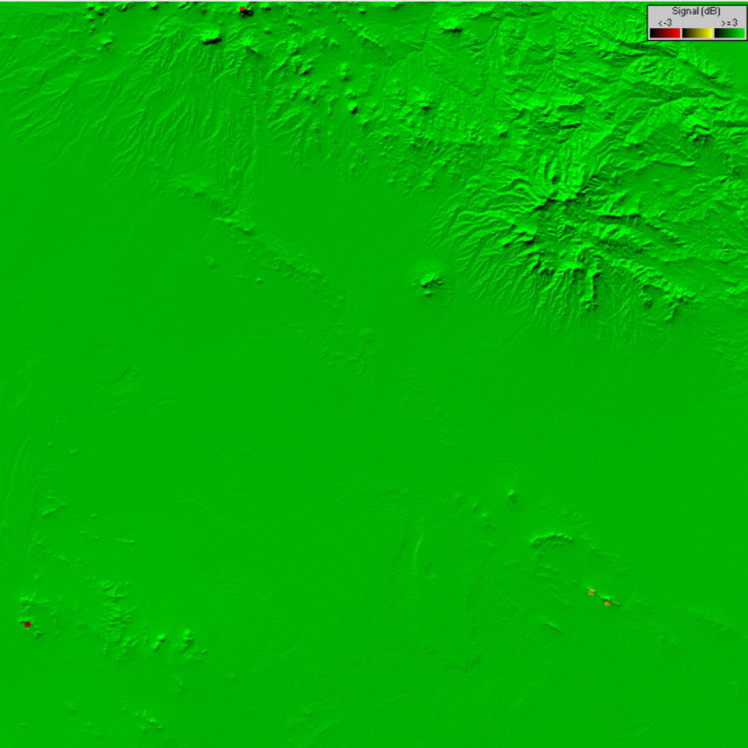
Results
The designated region of 100 km x 100 km is fully covered by the network configuration, confirming reliable end-user connectivity.
Total Area Covered: ~9978 km² (99.78 % of the area)

Slide 12
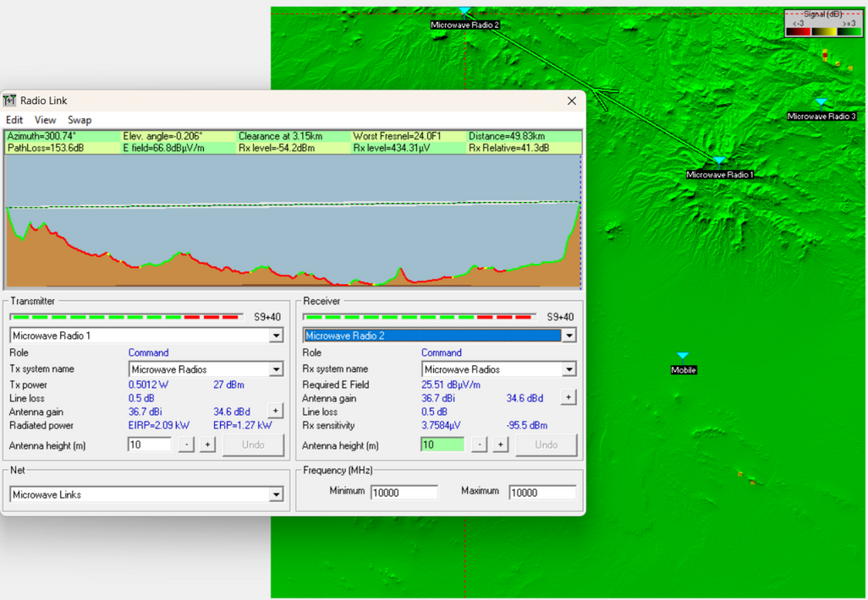
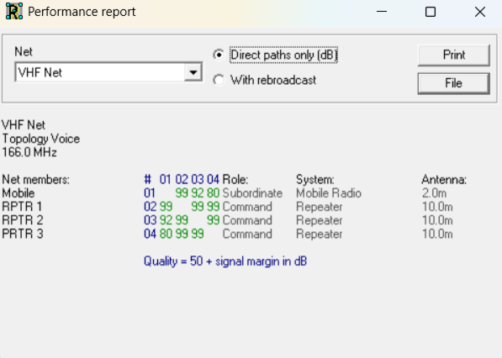
Results
All links are built with at least a 10 dB safety margin above the modulation threshold.
In order to maintain network integrity, each repeater uses microwave links to connect to at least two other repeaters.
The link between the microwave radios is green, and it means there is no blockage between them.

Slide 13
Conclusion
The final system implementation successfully delivers a robust, wide-area PMR network with:
Full coverage of the area,
Exceptionally high signal integrity throughout,
Minimal infrastructure deployment (just 3 repeaters),
This setup strikes an excellent balance between performance, cost, and scalability, making it suitable for future expansion or deployment in similar geographic conditions.

Slide 14
Thank you

